Slide 1
Chapter 10
Binary Trees(二叉树）

Slide 2
Content Points
Binary Trees
Binary Search Trees
Building a Binary Search Tree
Height Balance: AVL Trees

Slide 3
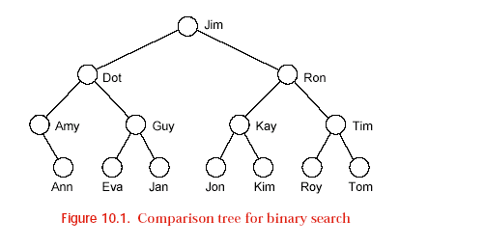

Slide 4

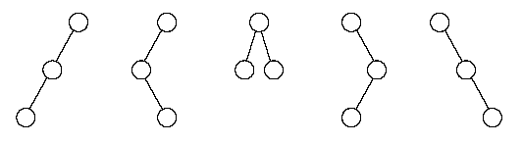
Binary Trees
（二叉树）
Definitions:
  A binary tree is either empty, or it consists of a node（结点） called the root（根） together with two binary trees called the left subtree （左子树）and the right subtree（右子树） of the root.
  Base Statues:
    Two nodes:
    Three nodes:

Slide 5
1、空二叉树
2、只有根结点
3、左子树不空
4、右子树不空
5、左右子树都不空
null

Slide 6
Binary Trees
Traversal of Binary Trees
  At a given node there are three tasks to do in some order: Visit（访问） the node itself (V); traverse its left subtree（左子树） (L); traverse its right subtree（右子树） (R).
    V L R L V R L R V
    preorder（前序） inorder（中序） postorder（后序）
  With preorder traversal we first visit a node, then traverse its left subtree, and then traverse its right subtree.
  With inorder traversal we first traverse the left subtree, then visit the node, and then traverse its right subtree.
  With postorder traversal we first traverse the left subtree, then traverse the right subtree, and finally visit the node.

Slide 7
举例：
A
B
D
C
E
preorder:
inorder:
postorder:
ABCDEF
F
BCADFE
CBFEDA

Slide 8
已知某二叉树的前序序列为：BDCEAFHG
中序序列为：DECBHGFA
画出此二叉树。

Slide 9
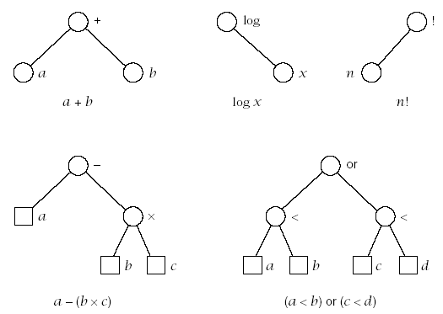
Binary Trees
Expression Trees

Slide 10
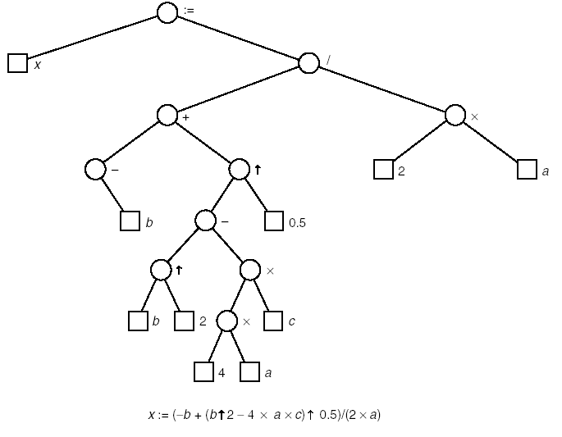

Binary Trees
Expression Trees

Slide 11
对树的遍历操作 | 表达式的形式
前序序列 | 前缀表达式
中序序列 | 中缀表达式
后序序列 | 后缀表达式
对二分查找的比较树的中序遍历得到有序序列

Slide 12

二叉树
的重要特性

Slide 13
性质 1 ： 在二叉树的第 i 层上至多有2^{i} 个结点。 (i≥0)
用归纳法证明：
归纳基：
归纳假设：
归纳证明：
i = 0 层时，只有一个根结点：
2^{i} = 2⁰ = 1；
假设对所有的 j，1≤ j < i，命题成立；
二叉树上每个结点至多有两棵子树，
则第 i 层的结点数 = 2^{i-1}× 2 = 2^{i} 。

Slide 14
性质 2 ：
深度为 k 的二叉树上至多含 2^{k+1}-1 个结点（k≥0）。
证明：
基于上一条性质，深度为 k 的二叉树上的结点数至多为
2⁰+2¹+ ⋅ ⋅ ⋅ ⋅ ⋅ ⋅ +2^{k} = 2^{k+1}-1 。

Slide 15
性质 3 ：
对任何一棵二叉树，若它含有n₀ 个叶子结点、n₂ 个度为 2 的结点，则必存在关系式：n₀ = n₂+1。
证明：
设 二叉树上结点总数 n = n₀ + n₁ + n₂
又 二叉树上分支总数 b = n₁+2n₂
而 b = n-1 = n₀ + n₁ + n₂ - 1
由此， n₀ = n₂ + 1 。

Slide 16
两类特殊的二叉树：
1
满二叉树：指的是深度为k且含有2^{k+1}-1个结点的二叉树。
2
3
4
5
6
7
8
9
10
11
12
13
14
15
完全二叉树：树中所含的 n 个结点和满二叉树中编号为 1 至 n 的结点一一对应。
a
b
c
d
e
f
g
h
i
j

Slide 17
性质 4 ： 具有 n 个结点的完全二叉树的深度为 ⎣ log₂n⎦ 。
证明：
设完全二叉树的深度为 k
则根据第二条性质得 2^{k}≤ n < 2^{k+1}
即 k ≤ log₂ n < k+1
因为 k 只能是整数，因此， k =⎣log₂n⎦ 。

Slide 18
性质 5 ：
若对含 n 个结点的完全二叉树从上到下且从左至右进行 1 至 n 的编号，则对完全二叉树中任意一个编号为 i 的结点：
(1) 若 i=1，则该结点是二叉树的根，无双亲，
否则，编号为 ⎣i/2⎦ 的结点为其双亲结点；
(2) 若 2i>n，则该结点无左孩子，
否则，编号为 2i 的结点为其左孩子结点；
(3) 若 2i+1>n，则该结点无右孩子结点，
否则，编号为2i+1 的结点为其右孩子结点。

Slide 19
二叉树的顺序存储：
  带空链的方式
  补成完全二叉树-借助层次遍历的顺序进行存储

Slide 20
二叉树的存储
补成完全二叉树的顺序存储：
  基本思想：
    一般二叉树⬄完全二叉树⬄从根开始，从上向下，从左向右编号，再将结点存储到相应编号中
  例如：
A
B
C
D
E
F

Slide 21
二叉树的存储
顺序存储：
  求双亲/孩子，可利用性质5进行
  仅适用于接近完全二叉树的二叉树类型；否则会造成大量空间的浪费
  例如：
A
B
C
D
E

Slide 22
二叉树存储
链式存储
  二叉链存储方式(基本思想：类似单链表)
    结点：
    描述：
    struct Node{
    ElemType data;
    struct Node *lchild,*rchild;
    };
    特点：求双亲困难
lchild
data
rchild

Slide 23
二叉树存储
链式存储
  三叉链存储方式(基本思想：类似双向链表)
    结点：
    描述：
    struct Node{
    ElemType data;
    struct Node *lchild,*rchild;
    struct Node *parent；
    };
lchild
data
parent
rchild

Slide 24
Linked Binary Tree
left data right
root
A
∧
∧
B
D
∧
∧
∧
C
E
∧
∧
F

Slide 25

Linked Binary Tree Specifications（链式二叉树规格说明）
  Binary Tree Class
    template <class Entry>
    class Binary_tree {
    public:
    // Add methods here.
    protected:
    // Add auxiliary function prototypes here.
    Binary_node<Entry> *root;
    };

Slide 26
Linked Binary Tree Specifications（链式二叉树规格说明）
Binary node class：（二叉树结点类）
      template <class Entry>
      struct Binary_node {
      // data members:
      Entry data;
      Binary_node<Entry> *left;
      Binary_node<Entry> *right;
      // constructors:
      Binary_node( );
      Binary_node(const Entry &x);
      };

Slide 27
Linked Binary Tree Specifications（链式二叉树规格说明）
  Constructor:（初始化）
    template <class Entry>
    Binary_tree<Entry> :: Binary_tree( )
    /* Post: An empty binary tree has been created. */
    {
    root = NULL;
    }

Slide 28
Linked Binary Tree Specifications（链式二叉树规格说明）
  Empty:（判空）
    template <class Entry>
    bool Binary_tree<Entry> :: empty( ) const
    /* Post: A result of true is returned if the binary tree is empty. Otherwise, false is returned. */
    {
    return root == NULL;
    }

Slide 29
Linked Binary Tree Specifications（链式二叉树规格说明）
  Inorder traversal:（中序遍历）
      template <class Entry>
      void Binary_tree<Entry> :: inorder(void (*visit)(Entry &))
      /* Post: The tree has been been traversed in inorder sequence.
      Uses: The function recursive_inorder */
      {
      recursive_inorder(root, visit);
      }

Slide 30
Linked Binary Tree Specifications（链式二叉树规格说明）
  Most Binary tree methods described by recursive processes can be implemented by calling an auxiliary（辅助的）recursive function that applies to subtrees.

Slide 31
Linked Binary Tree Specifications（链式二叉树规格说明）
    template <class Entry>
    void Binary_tree<Entry> ::recursive_inorder(Binary_node<Entry> *sub_root,void (*visit)(Entry &))
    {
    if (sub_root != NULL)
    {
    recursive_inorder(sub_ root->left, visit);
    (*visit)(sub_root->data);
    recursive_inorder(sub_root->right, visit);
    }
    }

Slide 32
Linked Binary Tree Specifications（链式二叉树规格说明）
    template <class Entry>
    class Binary_tree {
    public:
      Binary_tree( );
      bool empty( ) const;
      void preorder(void (*visit)(Entry &));
      void inorder(void (*visit)(Entry &));
      void postorder(void (*visit)(Entry &));
      int size( ) const;
      void clear( );
      int height( ) const;
      void insert(const Entry &);

Slide 33
Linked Binary Tree Specifications（链式二叉树规格说明）
    Binary_tree (const Binary tree<Entry> &original);
    Binary_tree & operator = (const Binary_tree<Entry> &original);
    ~Binary_tree( );
    …..
  protected:
  // Add auxiliary function prototypes here.
    Binary_node<Entry> *root;
  };

Slide 34
补充题：
写出二叉树结点计数的算法。
template <class Entry>
int Binary_tree<Entry> :: recursive_size(Binary_node<Entry> *sub_root) const
/* Post: The number of entries in the subtree rooted at sub_root is returned. */
{
}
  if (sub_root == NULL) return 0;
  return 1+recursive_size (sub_root->left)+ recursive_size (sub_root->right));

Slide 35
统计二叉树高度的算法
template <class Entry>
int Binary_tree<Entry> :: recursive_height(Binary_node<Entry> *sub_root) const
/* Post: The height of the subtree rooted at sub_root is returned. */
{
  if (sub_root == NULL) return 0;
  int l = recursive_height(sub_root->left);
  int r = recursive_height(sub_root->right);
  if (l > r) return 1 + l;
  else return 1 +r;
}

Slide 36
拷贝构造函数
template <class Entry>
Binary_node<Entry> *Binary_tree<Entry> :: recursive_copy(
Binary_node<Entry> *sub_root)
/* Post: The subtree rooted at sub_root is copied, and a pointer to the root of the new copy is returned. */
{
  if (sub_root == NULL) return NULL;
  Binary_node<Entry> *temp = new Binary_node<Entry>(sub_root->data);
  temp->left = recursive_copy(sub_root->left);
  temp->right = recursive_copy(sub_root->right);
  return temp;
}

Slide 37
二叉树清空
template <class Entry>
void Binary_tree<Entry> ::clear()
{
recursive_clear(root);
}
template <class Entry>
void Binary_tree<Entry>::recursive_clear(Binary_node<Entry> * &sub_root)
{
if (sub_root != NULL)
{
recursive_clear(sub_root->left);
recursive_clear(sub_root->right);
delete sub_root;
sub_root=NULL;
}
}

Slide 38
叶子结点删除
template <class Entry>
void Binary_tree<Entry>:: recursive_deleteleaf(Binary_node<Entry>* &sub_root){
if(sub_root==NULL)
return;
if (sub_root->left==NULL && sub_root->right==NULL)
{delete sub_root;sub_root=NULL;return;}
recursive_deleteleaf(sub_root->left);
recursive_deleteleaf(sub_root->right);
}
template <class Entry>
void Binary_tree<Entry>:: deleteleaf()
{recursive_deleteleaf(root);
}

Slide 39
Level traversal
设置一个队列
root指针入队
在队列非空时{
  出队p
  访问p->data
  将p的非空左右孩子入队
}

Slide 40
Non_recursive Inorder traversal
p=t (t为二叉树的根)
成立
不成立
p!=NULL
p=pop(s)
(出栈)
p入栈
访问p结点的信息
p=p->lchild
(p切换成左孩子）
p=p->rchild
(p切换成右孩子）

Slide 41
Non_recursive inorder traversal
设置一个空栈S
设置活动指针p，初值p=root
当栈S不空时或p不空时，执行循环{
  当p不为NULL时重复循环：p入栈，p=p->left;
  当S不空时，出栈栈顶p，访问p->data
  p=p->right
}

Slide 42
1、二叉树的逻辑定义
2、二叉树的三种遍历序列
3、二叉树遍历与表达式树
4、二叉树的链式实现（二叉链表）
5、二叉链表下的递归算法
总体思路：
将二叉树分成三部分。
运用递归特性。
前序、中序、后序遍历、求结点数、深度等的算法。
有一个公共方法，呈现给客户程序。
有一个私有辅助递归函数。
6、层次遍历算法
7、前序、中序、后序的非递归算法

Slide 43
更多算法
以两个序列创建二叉链表
统计度为1的结点数
统计度为2的结点数
统计二叉树的宽度
计算二叉树中指定结点p所在层次
计算二叉树中最大元素值
删除度为1的结点数
……

Slide 44
Binary Search Trees
（二叉查找树、二叉排序树）
DEFINITION:(a recursive definition)
  A binary search tree is a binary tree that is either empty or in which every node has a key（关键字） and satisfies the following conditions:
    The key of the root is greater than the key in any node in the left subtree of the root.
    The key of the root is less than the key in any node in the right subtree of the root..
    The left and right subtrees of the root are again binary search trees.

Slide 45
Binary Search Trees
DEFINITION:
  No two entries in a binary search tree may have equal keys.(没有两个记录的关键字是一样的）
  We can regard binary search trees as a new ADT.
  We may regard binary search trees as a specialization of binary trees.（二叉查找树是二叉树的一个特例）
  We may study binary search trees as a new implementation of the ADT ordered list.（可以把二叉查找树作为有序表的一种实现方法。）

Slide 46
Binary Search Trees
implementations:
  The Binary Search Tree Class（二叉查找树类）
    The binary search tree class will be derived from the binary tree class; hence all binary tree methods are inherited（继承）.
  template <class Record>
  class Search_tree: public Binary_tree<Record> {
  public:
    Error_code insert(const Record &new_data);
    Error_code remove(const Record &old_data);
    Error_code tree_search(Record &target) const;
  private: // Add auxiliary function prototypes here.
  };

Slide 47
Binary Search Trees
implementations:
  The inherited methods include the constructors, the destructor, clear, empty, size, height, and the traversals preorder, inorder, and postorder.
  A binary search tree also admits specialized methods called insert, remove(删除）, and tree search（树查找）.
  The class Record has the behavior outlined in Chapter 7: Each Record is associated with a Key. The keys can be compared with the usual comparison operators(比较运算符）. By casting records to their corresponding keys, the comparison operators apply to records as well as to keys.

Slide 48
例如:
50
30
80
20
40
90
10
25
35
66
85
23
88
不
是二叉查找树。
查找23；86

Slide 49
Binary Search Trees
  Tree Search
  Public method for tree search:
  Error_code Search_tree<Record> ::Tree_search(Record &target) const;
  /*Post: If there is an entry in the tree whose key matches(符合） that in target, the parameter（参数） target is replaced by the corresponding record from the tree and a code of success is returned. Otherwise a code of not_present is returned.*/
    This method will often be called with a parameter target that contains only a key value. The method will fill target with the complete data belonging to any corresponding Record in the tree.

Slide 50
Binary Search Trees
Implementations
Tree Search
    We program the searching process by calling an auxiliary recursive function.
    We first compare it with the entry at the root of the tree. If their keys match, then we are finished.
    Otherwise, we go to the left subtree or right subtree as appropriate and repeat the search in that subtree.
    The process terminates(终止) when it either finds the target or hits an empty subtree.
    The auxiliary search function returns a pointer to the node that contains the target back to the calling program.

Slide 51
Binary Search Trees
implementations
    Binary_node<Record> *Search_tree<Record> :: search_for_node(
    Binary_node<Record>* sub_root, const Record &target) const;
    /*Pre: sub_root is NULL or points to a subtree of a Search_tree
    Post: If the key of target is not in the subtree, a result of NULL is returned. Otherwise, a pointer to the subtree node containing the target is returned.*/

Slide 52
  Recursive function
  template <class Record>
  Binary_node<Record> *Search_ tree<Record> :: search_for_node(
  Binary_node<Record>* sub_root, const Record &target) const
  {
  if (sub_root == NULL || sub_root->data == target)
  return sub_root;
  else if (sub_root->data < target)
  return search_for_ node(sub_ root->right, target);
  else return search_ for_ node(sub_ root->left, target);
  }

Slide 53
Nonrecursive version:
template <class Record>
Binary_ node<Record> *Search_ tree<Record> :: search_for_ node(
Binary_ node<Record> *sub_ root, const Record &target) const
{
while (sub_ root != NULL && sub_root->data != target)
if (sub_ root->data < target)
sub_ root = sub_ root->right;
else
sub_ root = sub_ root->left;
return sub_ root;
}

Slide 54
Binary Search Trees
implementations:
  Public method for tree search:
  template <class Record>
  Error_code Search_tree<Record> ::tree_search(Record &target) const
  {
    Error_code result = success;
    Binary_node<Record> *found = search_for_node(root, target);
    if (found == NULL)
    result = not_present;
    else
    target = found->data;
    return result;
  }

Slide 55
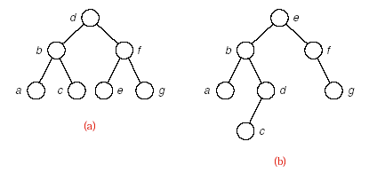
Binary Search Trees
Binary Search Trees with the Same Keys(具有同一组关键字的二叉查找树）

Slide 56
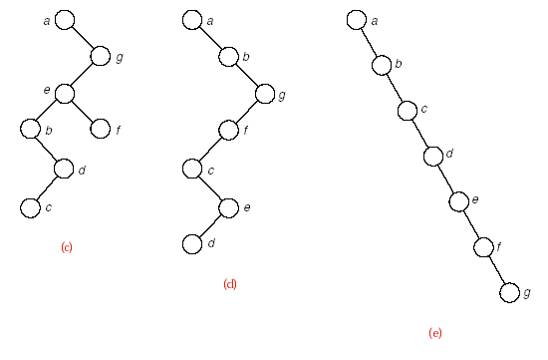
Binary Search Trees
Binary Search Trees with the Same Keys(具有同一组关键字的二叉查找树）

Slide 57
Binary Search Trees
implementations:
  Analysis of Tree Search
    Draw the comparison tree(比较树） for a binary search (on an ordered list). Binary search on the list does exactly the same comparisons as tree search will do if it is applied to the comparison tree. By Section 7.4, binary search performs O（log n） comparisons for a list of length n. This performance（性能） is excellent in comparison to other methods, since logn grows very slowly as n increases.

Slide 58
Binary Search Trees
implementations:
  Analysis of Tree Search
    The same keys may be built into binary search trees of many different shapes.
    If a binary search tree is nearly completely balanced(平衡的） (“bushy”), then tree search on a tree with n vertices（顶点） will also do O（log n） comparisons of keys.
    If the tree degenerates into a long chain(链）, then tree search becomes the same as sequential search（顺序查找）, doing O(n) comparisons on n vertices. This is the worst case for tree search.
    The number of vertices between the root and the target, inclusive（包括它们）,is the number of comparisons that must be done to find the target. The bushier the tree, the smaller the number of comparisons that will usually need to be done.

Slide 59
Binary Search Trees
implementations:
  Analysis of Tree Search
    It is often not possible to predict (预测）(in advance of building it) what shape of binary search tree will occur.
    In practice, if the keys are built into a binary search tree in random order（以随机次序）, then it is extremely unlikely that a binary search tree degenerates badly; tree_search usually performs almost as well as binary search.

Slide 60
Binary Search Trees
implementations:
  Insertion into a Binary Search Tree
  Error_code Search_tree<Record> ::insert(const Record &new_data);
    /*Post: If a Record with a key matching that of new data already belongs to the Search_tree ,a code of duplicate(重复的） error is returned. Otherwise, the Record new_data is inserted into the tree in such a way that the properties(性质） of a binary search tree are preserved, and a code of success is returned.*/

Slide 61
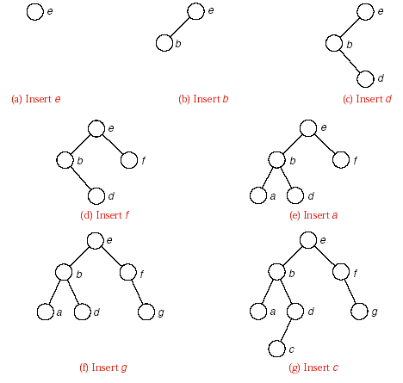
Binary Search Trees
implementations:
  Insertion into a Binary Search Tree

Slide 62
Binary Search Trees
implementations
  Insertion into a Binary Search Tree
    template <class Record>
    Error_code Search_tree<Record> :: insert(const Record &new_data)
    {
    return search_and_insert(root, new_data);
    }

Slide 63
Binary Search Trees
implementations:
  Insertion into a Binary Search Tree
    template <class Record>
    Error_code Search_tree<Record> :: search_and_insert(
    Binary_node<Record> * &sub_root, const Record &new_data)
    {
      if (sub_root == NULL) {
      sub_root = new Binary_node<Record>(new_data);
      return success;
      }
      else if (new_data < sub_root->data)
      return search_and_insert(sub_root->left, new_data);
      else if (new_data > sub_root->data)
      return search_and_insert(sub_root->right, new_data);
      else return duplicate_error;
    }

Slide 64
Binary Search Trees
implementations:
  Insertion into a Binary Search Tree
    The method insert can usually insert a new node into a random binary search tree with n nodes in O(log n) steps. It is possible, but extremely unlikely, that a random tree may degenerate （退化）so that insertions require as many as n steps.
    If the keys are inserted in sorted order(有序次序） into an empty tree, however, this degenerate case will occur.

Slide 65
implementations:
  Removal（删除） from a Binary Search Tree

Slide 66
（1）被删除的结点是叶子结点
例如:
被删关键字 = 20
88
50
30
80
20
40
90
35
85
32
88
其双亲结点中相应指针域的值改为“空”

Slide 67
（2）被删除的结点只有左子树
或者只有右子树
被删关键字 = 40
80
50
30
80
20
40
90
35
85
32
88
其双亲结点的相应指针域的值改为 “指向被删除结点的左子树或右子树”。

Slide 68
（3）被删除的结点既有左子树，也有右子树
被删关键字 = 50
50
40
30
80
20
40
40
90
35
85
32
88
前驱结点
被删结点
以其前驱替代之，然后再删除该前驱结点

Slide 69
Binary Search Trees
implementations:
  Removal Method
  template <class Record>
  Error_code Search_tree<Record> :: remove(const Record &target)
  /* Post: If a Record with a key matching(符合） that of target belongs to the Search_tree a code of success is returned and the corresponding node is removed from the tree. Otherwise, a code of not_present is returned.
  Uses: Function search_and_destroy */
  {
return search_and_destroy(root, target);
}

Slide 70
Binary Search Trees
implementations
  Removal Method
  template <class Record>
  Error_code Search_tree<Record> :: search_and_destroy(
  Binary_node<Record>* &sub_root, const Record &target)
  /* Pre: sub_root is either NULL or points to a subtree of the Search_tree .
  Post: If the key of target is not in the subtree, a code of not_present is returned. Otherwise, a code of success is returned and the subtree node containing target has been removed in such a way that the properties of a binary search tree have been preserved.
  Uses: Functions search_and_destroy recursively and remove_root */

Slide 71
Binary Search Trees
implementations
  Removal Method
  {
    if (sub_root == NULL || sub_root->data == target)
    return remove_root(sub_root);
    else if (target < sub_root->data)
    return search_and_destroy(sub_root->left, target);
    else
    return search_and_destroy(sub_root->right, target);
  }

Slide 72
Binary Search Trees
implementations:
  Auxiliary（辅助的） Function to Remove One Node
  template <class Record>
  Error_code Search_tree<Record> :: remove_root(Binary_node<Record> * &sub_root)
  /* Pre: sub_root is either NULL or points to a subtree of the Search_tree .
  Post: If sub_root is NULL , a code of not_present is returned. Otherwise, the root of the subtree is removed in such a way that the properties of a binary search tree are preserved. The parameter sub_root is reset as the root of the modified subtree, and success is returned. */

Slide 73
Binary Search Trees
implementations:
  Auxiliary Function to Remove One Node
  {
    if (sub_root == NULL) return not_present;
    Binary_node<Record> *to_delete = sub_root;
    // Remember node to delete at end.
    if (sub_root->right == NULL) sub_root = sub_root->left;
    else if (sub_root->left == NULL) sub_root = sub_root->right;
    else { // Neither subtree is empty.
    to_delete = sub_root->left;
    // Move left to find predecessor(前驱）.
    Binary_node<Record> *parent = sub_root; // parent of to_delete

Slide 74
Binary Search Trees
implementations
  Auxiliary Function to Remove One Node
    while (to_delete->right != NULL)
    { // to delete is not the predecessor.
      parent = to_delete;
      to_delete = to_delete->right;
    }
    sub_root->data = to_delete->data; // Move from to_delete to root.
    if (parent == sub_root) sub_root->left = to_delete->left;
    else parent->right = to_delete->left;
  }
  delete to_delete; //Remove to_delete from tree.
  return success;
}

Slide 75
Binary Search Trees
implementations:
  Treesort（树排序）
    When a binary search tree is traversed in inorder, the keys will come out in sorted order.
    This is the basis for a sorting method, called treesort: Take the entries to be sorted, use the method insert to build them into a binary search tree, and then use inorder traversal to put them out in order.

Slide 76
Binary Search Trees
implementations:
  Treesort（树排序）
    Theorem（定理） 10.1 Treesort makes exactly the same comparisons of keys as does quicksort（快速排序） when the pivot（基准） for each sublist（子表） is chosen to be the first key in the sublist.
    Corollary(推论） 10.2 In the average case, on a randomly ordered list of length n, treesort performs:2n ln n + O(n)= 1.39n lg n+ O(n) comparisons of keys.

Slide 77
Binary Search Trees
implementations:
  Advantages and Drawback of Tree sort
    First advantage(优点） of treesort over quicksort: The nodes need not all be available at the start of the process, but are built into the tree one by one as they become available.
    Second advantage: The search tree remains available for later insertions and removals（删除）.
    Drawback（缺点）: If the keys are already sorted, then treesort will be a disaster(灾难）--the search tree it builds will reduce to a chain.
    Treesort should never be used if the keys are already sorted, or are nearly so.

Slide 78
更多算法
找最大值（最小值）
判别是否为二叉查找树
以有序序列创建平衡二叉树……

Slide 79
Height Balance: AVL Trees
（平衡二叉树）
AVL Trees Definition：
  a binary tree
  the heights of left and right subtrees of the root differ by at most 1
  the left and right subtrees are again AVL trees
balance factor:
  depth of left subtree subtract depth of right subtree

Slide 80
Pointers and Pitfalls
1. Consider binary search trees as an alternative to ordered lists. At the cost of an extra pointer field in each node, binary search trees allow random access (with O(log n/)key comparisons) to all nodes while maintaining the flexibility of linked lists for insertions, deletions, and rearrangement.
2. Consider binary search trees as an alternative to tables. At the cost of access time that is O(log n) instead of O(1), binary
search trees allow traversal of the data structure in the order specied by the keys while maintaining the advantage of random access provided by tables.
3. In choosing your data structures, always carefully consider what operations will be required. Binary trees are especially appropriate when the requirements include random access, traversal in a predetermined order, and flexibility in making insertions and deletions.

Slide 81
Pointers and Pitfalls
4. While choosing data structures and algorithms, remain alert to the possibility of highly unbalanced binary search trees. AVL trees provide nearly perfect balance at a slight cost in computer time and space, but with considerable programming cost. If it is necessary for the tree to adapt dynamically to changes in the frequency of the data, then a splay tree may be the best choice.
5. Binary trees are defined recursively; algorithms for manipulating binary trees are usually, but not always, best written recursively.
6. Although binary trees are most commonly implemented as linked structures, remain aware of the possibility of other implementations.

Slide 82
1.画出三个结点的树和二叉树的所有不同形态。
2.已知一棵度为m的树中有n₁个度为1的结点， n₂个度为2的结点，…… ，n_{m}个度为m的结点，问该树中有多少片叶子？
3.找出分别满足下面条件的所有二叉树（非空形态）：
(a)前序序列和中序序列相同；
(b)中序序列和后序序列相同；
(c)前序序列和后序序列相同；
(d)前序序列、中序序列和后序序列都相同。

Slide 83
4.编写算法判断两棵二叉树是否等价。称二叉树T1和T2是等价的：如果T1和T2都是空的二叉树；或者T1和T2的根结点相同，并且T1的左子树和T2的左子树是等价的， T1的右子树和T2的右子树是等价的。
5.已知一棵二叉树的中序序列和后序序列分别为BDCEAFHG和DECBHGFA，画出这棵二叉树。
6．给定一棵用链表表示的二叉树，其根指针为root，试写出下列算法：
(1) 将树中所有结点的左右子树交换的算法．
(2) 按层次顺序遍历二叉树的算法．
(3) 先序遍历二叉树的非递归算法 .
本章上机习题
实现二叉树类，要求完成二叉树的建立，前序、中序、后序、层次遍历、二叉树深度、结点计数、叶结点计数等基本算法。

Slide 84
1. 画出三个结点的树和二叉树的所有不同形态。
解：树（两种）
二叉树（5种）

Slide 85
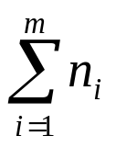
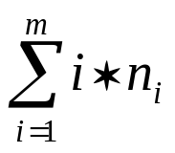
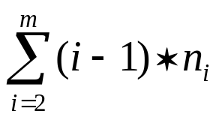
2. 已知一棵度为m的树中有n₁个度为1的结点， n₂个度为2的结点，…… ，n_{m}个度为m的结点，问该树中有多少片叶子？
解：叶子即度为0的结点，设有n₀个，并设该结点
总数为n，则
n=n₀+n₁+n₂+……+n_{m} =n₀ +
度为i的结点有i个子结点，除根结点不是任何结点的子结点外，其它结点都是且仅是某一个结点的子结点，所以：
n=n₁+2·n₂+……+m·n_{m}+1= +1
则： n₀ = +1- =1+

Slide 86
3.找出分别满足下面条件的所有二叉树（非空形态）：
（a)前序序列和中序序列相同；(左单枝)
(b)中序序列和后序序列相同；（右单枝）
(c)前序序列和后序序列相同；（只有根结点）
(d)前序序列、中序序列和后序序列都相同。 （只有根结点）
(a)
(b)
(c)
(d)

Slide 87
5. 已知一棵二叉树的中序序列和后序序列分别为BDCEAFHG和DECBHGFA，画出这棵二叉树。
A
A
A
BDCE
FHG
B
FHG
B
FHG
A
DCE
A
C
B
F
B
F
D
E
C
HG
C
G
D
E
D
E
H

Slide 88
template <class Entry>
void Binary_tree<Entry>::recursive_unknown1(Binary_node<Entry> *root, int i,void (*visit)(Entry &))
{
if(root!=NULL)
{
(*visit)(root->data);
cout<<" "<<i<<" ";
recursive_outlevel(root->left,i+1,visit);
recursive_outlevel(root->right,i+1,visit);
}
}
template <class Entry>
void Binary_tree<Entry>:: unknown1(void (*visit)(Entry &))
{
recursive_unknown 1(root,0,visit);
}

Slide 89
template <class Entry>
int Binary_tree<Entry>::recursive_unknown2(Binary_node<Entry> *root,Binary_node<Entry> *p)
{
if(p==NULL || root==NULL) return -1;
if(p==root)
return 0;
int l=recursive_level(root->left,p);
int r=recursive_level(root->right,p);
if (l>r) return l+1;
else
return r+1;
}
template <class Entry>
int Binary_tree<Entry>::unknown2(Binary_node<Entry> *p)
{
return recursive_unknown2(root,p);
}

